Slide 1


El Mundo vs El País
8 Golden Rules of Interface Design

Slide 2
 | El Mundo | El País
Strive for consistency | This web page has consistent color (blue), fonts, layout and capitalization. The categories are highlighted with blue. | This website uses white in its background and black in the letters , also highlights headlines, with a darker font.
Seek universal usability | The web page has shortcuts in the menu to filter the category of the news, the menu bar is more intuitive than El Pais. But it doesn't have a reader mode, so people with disabilities can’t access the web information. | The website does not have a reader mode, so blind people will not be able to access it. But the web has a lot of shortcuts, in the menu that is on the top of the site, so it's pretty intuitive.

Slide 3
 | El Mundo | El País
Offer informative feedback | When users login, the website sends a message that confirms that users did it successfully and they now can access all the services. | This website informs the user when they have registered correctly, it also informs the user if there is relevant news, via mail.
Design dialogs to yield closure | When an user wants to comment in any article or to subscribe in a newsletter the website moves the user to a page where they introduce the email or they log in, and later it moves the user to a page to do the action, like write a comment and send it. | When users want to write a comment, the web opens a small tab on the right, so they can do it in addition to giving the option to register if you have not done so before.

Slide 4
 | El Mundo | El País
Prevent errors | If the user wrongly introduces an email, the website deletes it and informs them that the email is incorrect when they press confirm. | If you put the email wrong, the web will notify you while you are writing. This will also happen with the password or the payment methods.
Permit easy reversal of actions | After the users create an account they can delete it, and when they login they also could sign off. When they write a comment they can delete it, and when they subscribe in a newsletter they can reverse the action. | The user can delete his account, sign off, temporarily deactivate it. If the user writes a comment, they can delete or edit it. Also, if users subscribe they can cancel their subscription

Slide 5
 | El Mundo | El País
Keep users in control | Users can choose if they want to receive promotional notifications or deactivate them, and even what type. | Users will be able to choose what types of notifications they want to receive, or even if they want to receive or not.
Reduce short-term memory load | The menu bar is simple and easy to use and all the news are sorted according to their release date. All the necessary information is on the main page. | This web has a problem, because all the information is not on the main page.

Slide 6
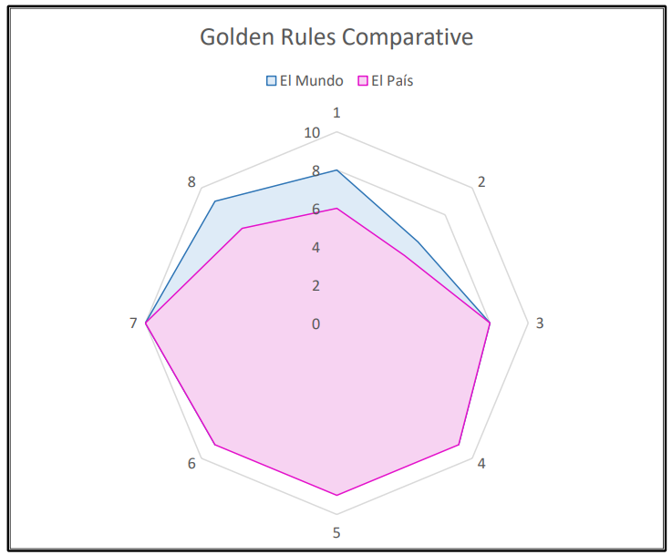
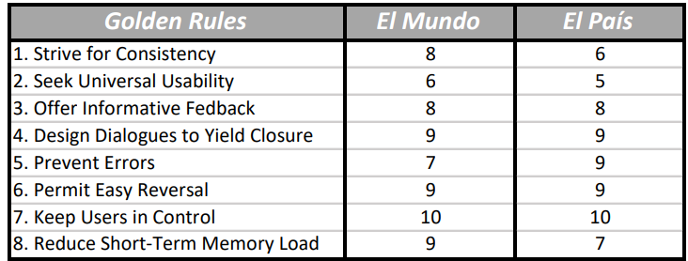
Kiviat Diagram

Slide 7
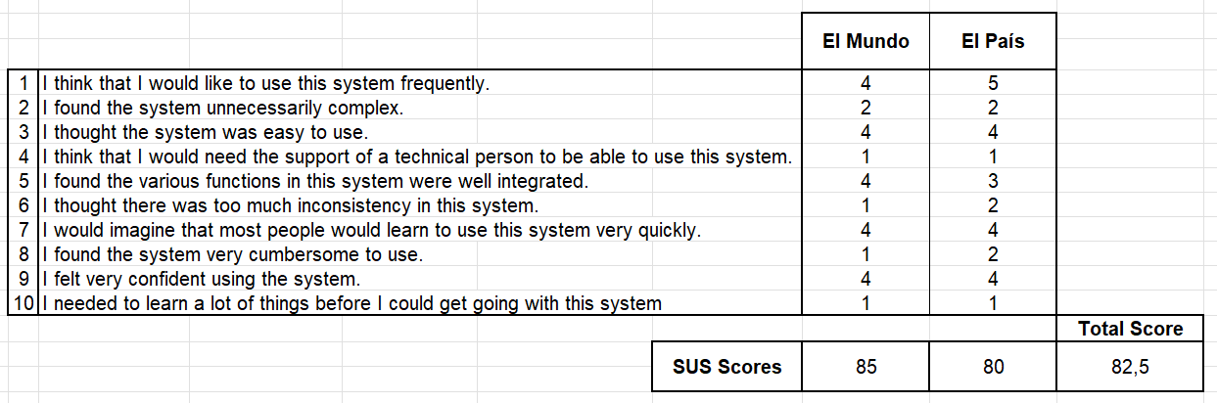
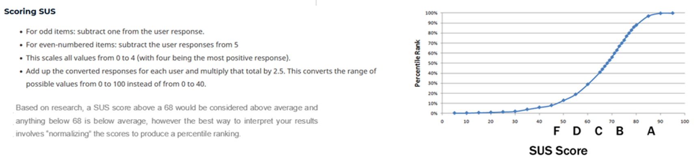
System Usability Scale Test

Slide 8
Conclusions
We think that these 8 rules should be 100% fulfilled in all web pages ,to provide all types of users with a good experience using the web and so that they spend as less time as possible trying to understand the use of the web. However, in the two that we have selected, for example, they did not have a read mode.
Another aspect to take into account is that in the newspaper ‘EL MUNDO’ you can select any category or subsection with a single click, however in ‘EL PAIS’, you would have to enter a general section to later see its subsections.
Thanks to this, ‘EL MUNDO’ has gained several points in the Keviat diagram, however, in prevent errors, it has lost several points since ‘EL PAIS’ notifies errors more clearly. However ‘El MUNDO’ has obtained a better score, in the two diagrams made, therefore in our opinion, and following the 8 golden rules, this web page has a better design.

